Slide 1
2. CNN Image classification
Convolution layer
Activation Function
Pooling
Fully Connected layer
Notes:
전통적인 이미지 분류 기술과 CNN이 가장 다른 점은 모델 스스로가 학습하여 적절한 features를 검출하기 위한 convolution filter 값을 찾아간다는 것
즉, 모델 스스로가 해당 분석 대상의 특징 점을 분석할 수 있게 학습

Slide 2
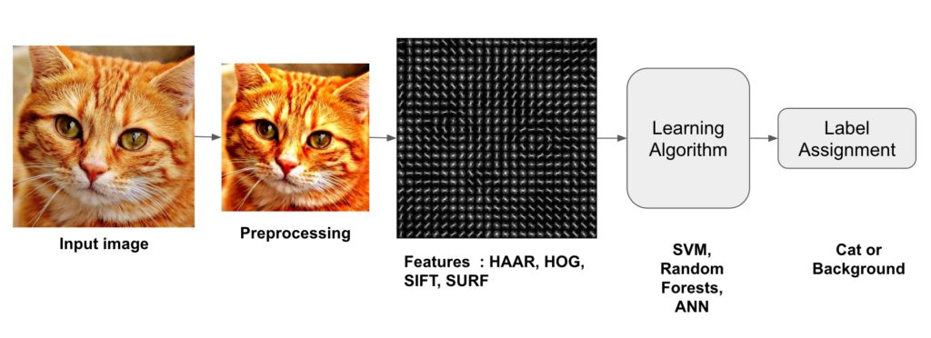
Image Classification A core task in Computer Vision
CNN
Data → Feature extraction → Classification
Notes:
https://darkpgmr.tistory.com/116

Slide 3
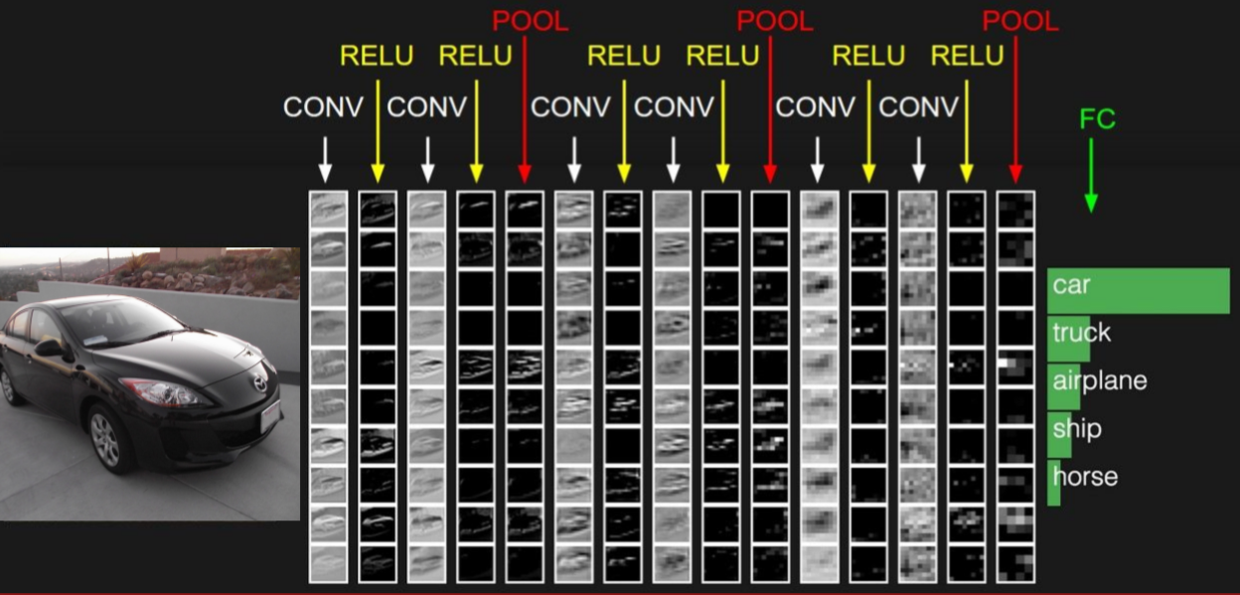
CNN (Convolutional Neural Networks)
convolution layer ➔ preserve spatial structure

Slide 4
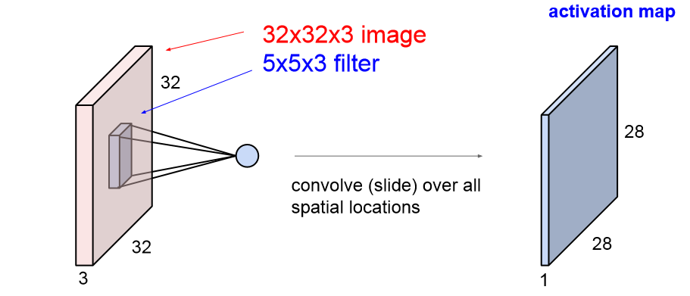
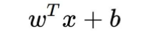
Convolution layer
Convolution layer
Convolution layer
weights
depth of the input value
maintain spatial structure
Notes:
신호처리 분야의 convolution에서는 실제로 필터를 뒤집은 다음에 연산을 수행
CNN은 의미적 요소만 가져와서 수행하기 때문에 느슨한 의미에서의 convolution(뒤집지 않는다)

Slide 5
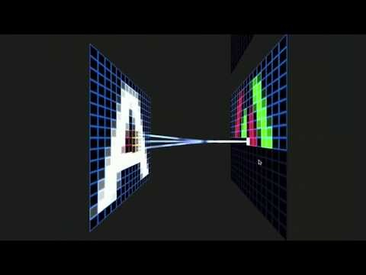
Convolution layer
Convolution layer
Convolution layer

Slide 6
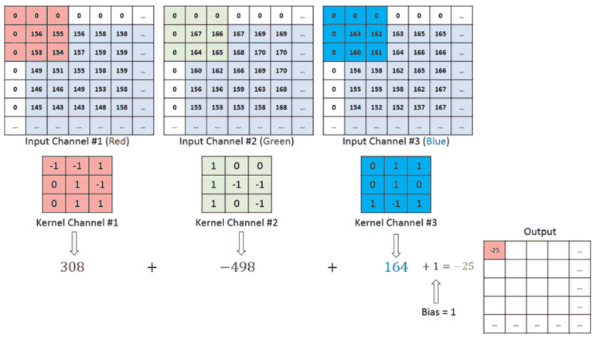

Convolution layer
Convolution layer
Notes:
https://towardsdatascience.com/a-comprehensive-guide-to-convolutional-neural-networks-the-eli5-way-3bd2b1164a53

Slide 7

Convolution layer
Convolution layer
Notes:
https://towardsdatascience.com/a-comprehensive-guide-to-convolutional-neural-networks-the-eli5-way-3bd2b1164a53

Slide 8
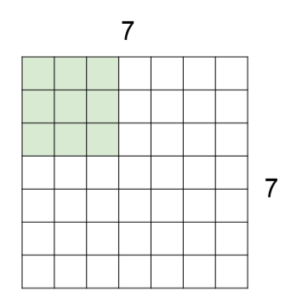
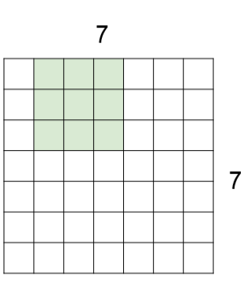
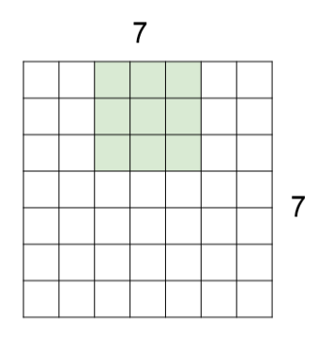
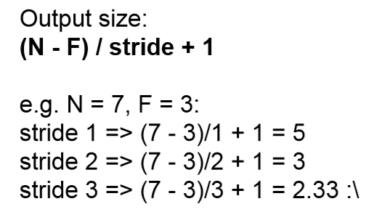
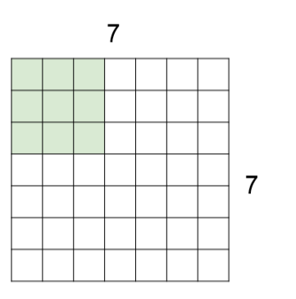
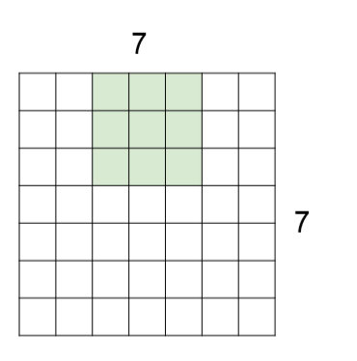
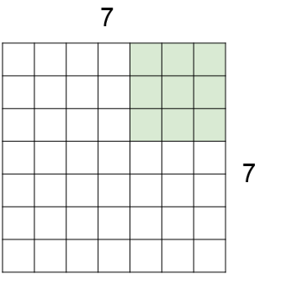
Stride
Convolution layer
stride = 1
stride = 3 ?
doesn’t fit!
stride = 2
stride ↑ output ↓
Notes:
Stride를 통해서 필터를 몇 칸씩 이동 시킬 지 결정
크기에 제한이 있다.

Slide 9
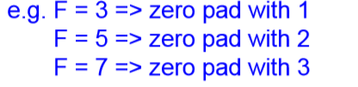
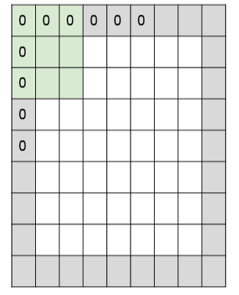

Padding
Convolution layer
To overcome
1. Shrinking outputs 2. Loosing information on corners of the image
Zero Padding
Input : W1 x H1 x D1
K : number of filters
F(w), F(h) : filter size(spatial extent)
S : the stride
P : the amount of zero padding
output : W2 x H2 x D2
W2 = (W1 – F(w) + 2P)/S + 1
H2 = (H1 – F(h) + 2P)/S + 1
D2 = K

Slide 10
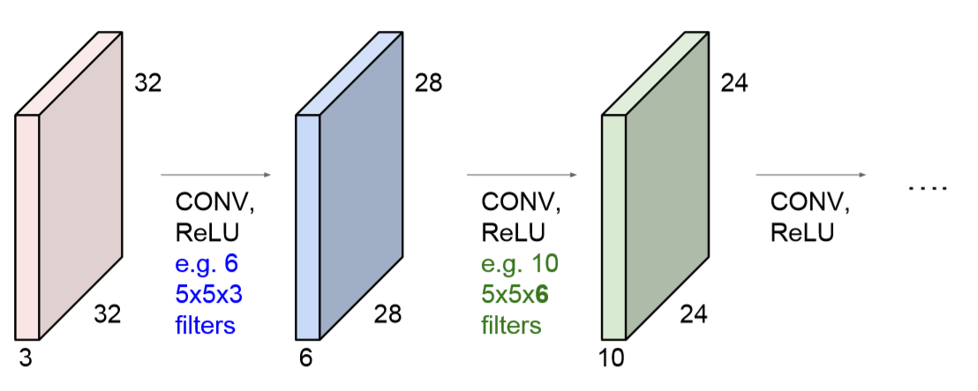
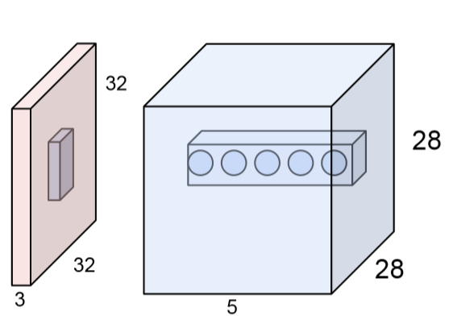
Convolution layer
Convolution layer
ouput of each layer → input of next layer
applying different filter from the same spatial location
Notes:
receptive field (5x5) : 뉴런이 한 번에 수용할 수 있는 영역

Slide 11
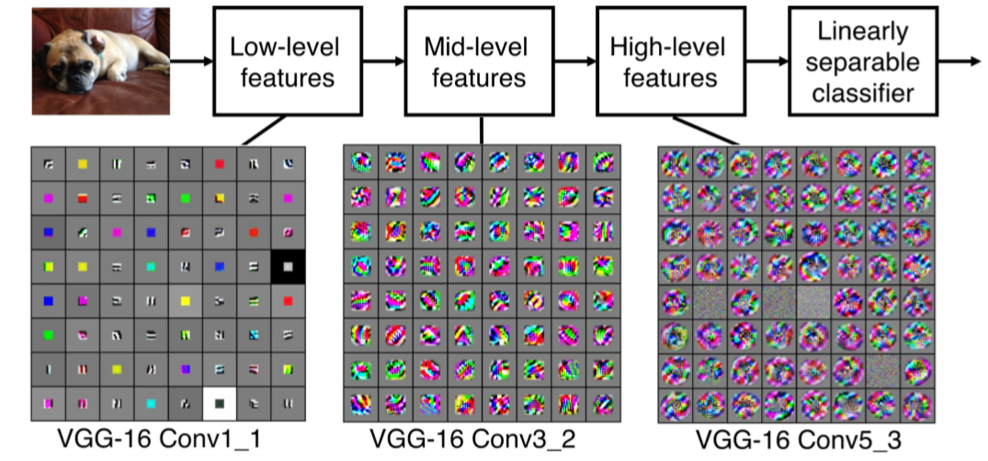
Filter
Convolution layer
edge
corner, blobs
more resemble concepts

Slide 12
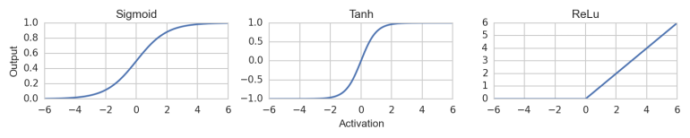

Activation function
Activation function
Gradient vanishing problem → ReLU!

Slide 13
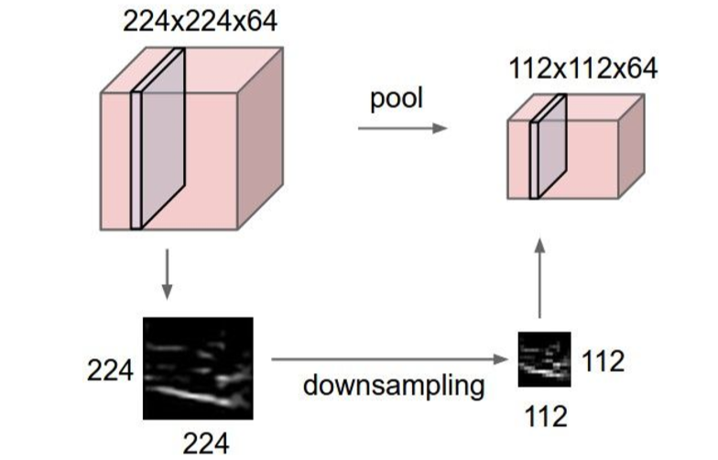

Pooling layer
Pooling
downsampling the size of activation maps

Slide 14
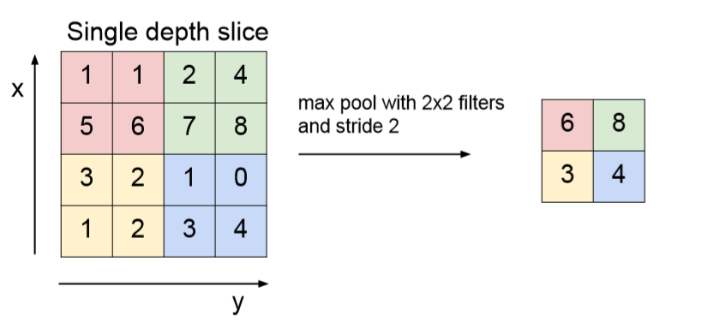
Max Pooling
Pooling
do not have any overlab
pooling layer : padding x
Notes:
strid와 같은 역할 아닌지? : 맞다. 같은 역할이고 pooling도 일종의 stride 기법이라고 할 수 있으며 stride가 더 좋은 성능을 보이기도 함
* downsampling을 하는 것이기 때문에 코너 값을 계산 못하는 경우도 없기에, padding을 고려하지 않아도 됨

Slide 15
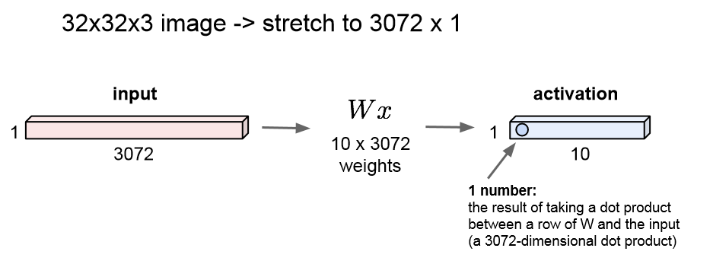
Convolution layer
Convolution layer
Fully Connected layer
Stretch all of the pixels out

Slide 16
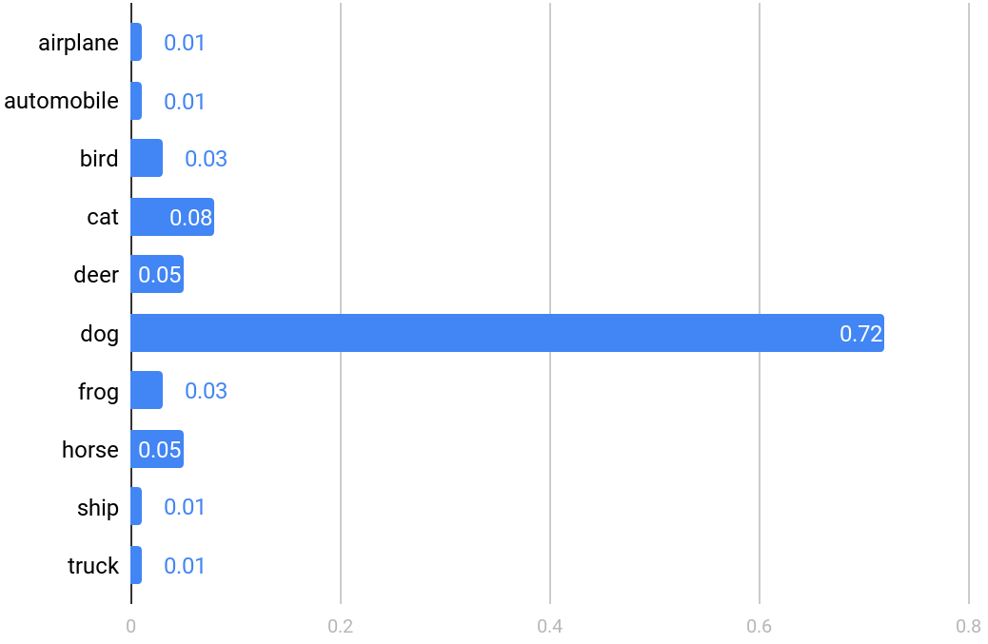
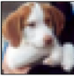
Fully connected layer
Fully connected layer
MaxPooling
2x2 filter
2 stride
MaxPooling
2x2 filter
2 stride
Input
3@32x32
Conv1
64@28x28
5x5 filter
1 stride
Conv2
64@10x10
5x5 filter
1 stride
Fc3
384
Fc4
192
stretch out last value → input of FC layer
score output

Slide 17
3. Transfer Learning
Transfer Learning
VGG-16
Image Augmentation
Notes:
전이학습
기존에 잘 설계되어있는 모델을 가져다 쓰기위한 학습 기법을 Transfer laerning이라고 한다.
(학습된 모델을 새로운 프로젝트에 적용)
이미지 분류용 모델
참고: https://bskyvision.com/504
VGGNet16(VGG16)
2014년 이미지넷 인식 대회에서 준우승을 차지, 사용하기 쉬운 구조와 좋은 성능 덕분에 많은 인기를 얻었던 모델이다.

Slide 18
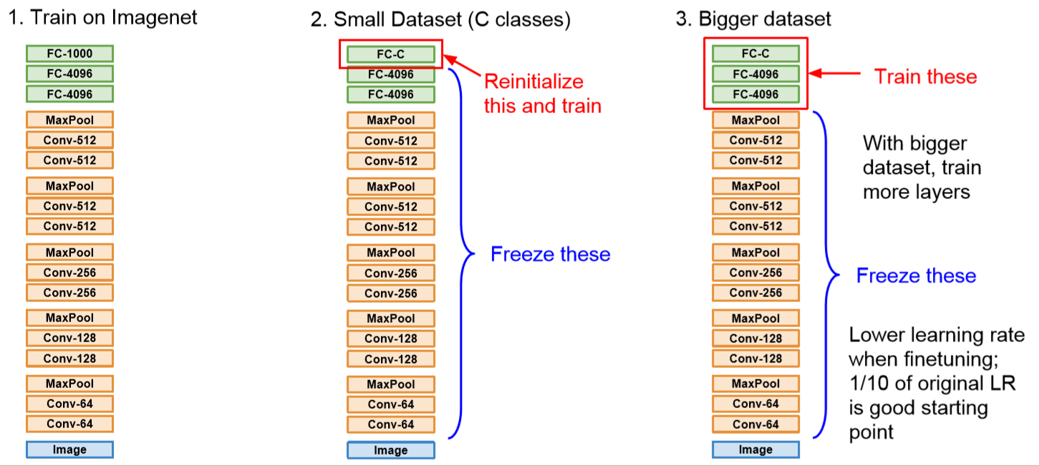
Transfer Learning
Transfer learning
Too few dataset → overfitting
Notes:
http://image-net.org/explore

Slide 19
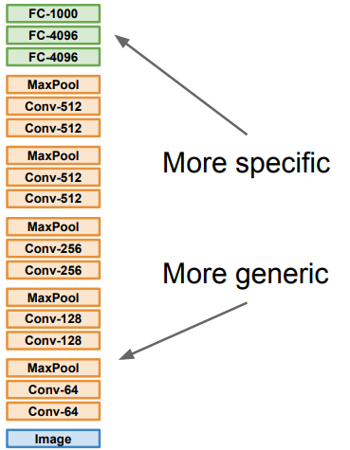
Fine tuning strategy
Transfer learning
 | Very similar dataset | Very different dataset
Very little data | Use Linear Classifier on top layer | Very difficult problems.. Try linear classifier from different stages
Quite a lot of data | Fine-tuning a few layers | Fine-tuning more layers

Slide 20
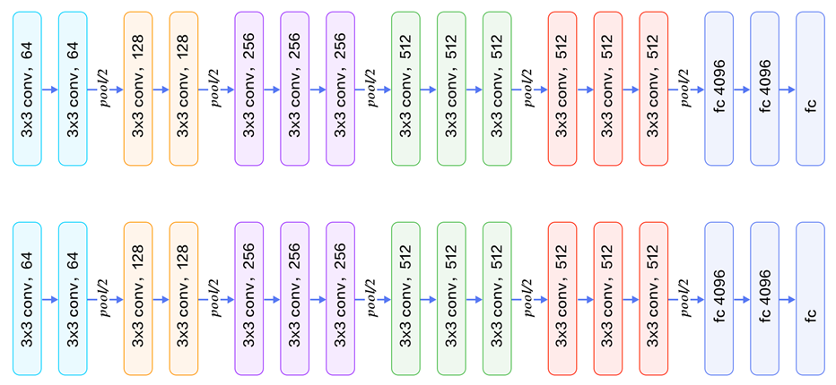
Fine-tuning VGG-16
Transfer learning
ImageNet
1000 classes
1000
1. Copy parameters
WBC
14 classes
14
2. Learn model with real dataset (fine-tuning)

Slide 21
Using Pre-trained Models
Transfer learning
In tensorflow, use TF-Slim library
AlexNet, VGGNet, ResNet, Inception, MobileNet
https://github.com/tensorflow/models/tree/master/research/slim
In pytorch, use TORCHVISION.MODELS library
AlexNet, VGG, ResNet, Inception v3, GoogLeNet, MobileNet v2, ….
https://pytorch.org/docs/stable/torchvision/models.html
Notes:
https://excelsior-cjh.tistory.com/160
http://euhyeji.blogspot.com/2017/01/tf-slim.html
https://jangjy.tistory.com/285
https://blog.naver.com/mudria/221045915684

Slide 22
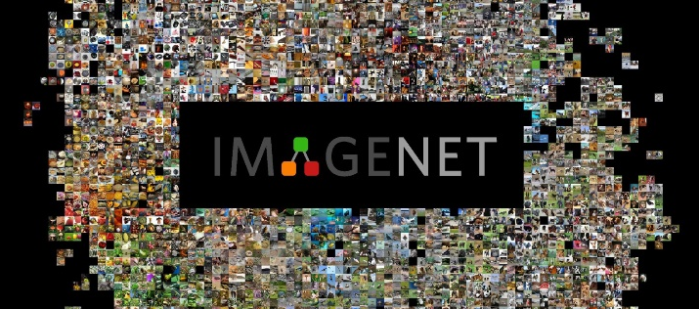
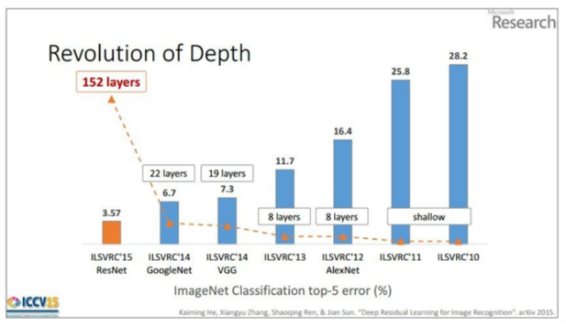
VGGNet
VGG16
Designed by Oxford (VGG16, VGG19)
Leads VGG to Second place in 2014 ILSVR (ImageNet Large Scale Visual Recognition Challenge)
Simple structure
Good performance

Slide 23
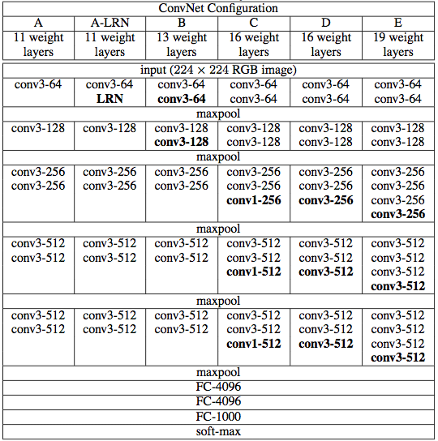
VGG16 Architecture
VGG16
Simonyan, Karen, and Andrew Zisserman. "Very deep convolutional networks for large-scale image recognition." arXiv preprint arXiv:1409.1556 (2014).
VGG16
VGG19

Slide 24
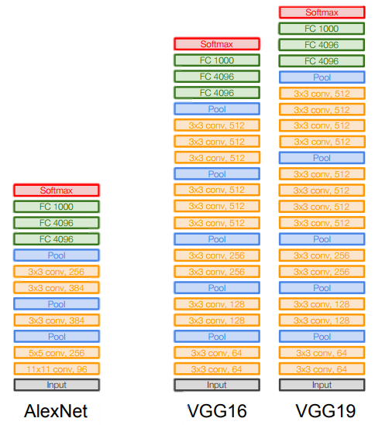
VGGNet
VGG16
Small filters, Deeper networks
Only 3x3 CONV stride 1, pad 1
and 2x2 MAX POOL stride 2
8 layers (AlexNet, 2012)
→ 16 – 19 layers (VGGNet)

Slide 25
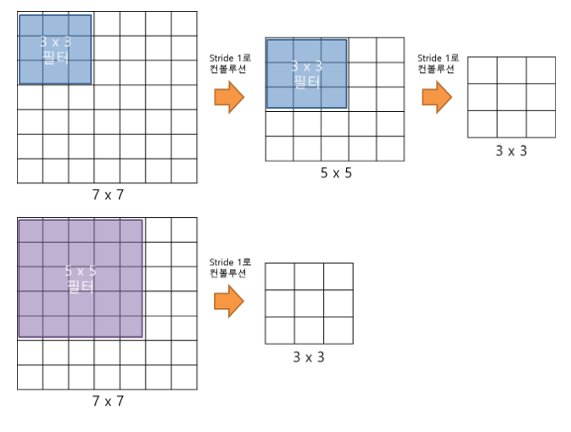
VGGNet
VGG16
Why use smaller filters? (3x3 conv)
Stack of three 3x3 conv (stride 1) layers has same effective receptive fields as
one 5x5 conv layer

Slide 26
VGGNet
VGG16
But deeper, more non-linearities
And fewer parameters: 2*(3*3*C) vs. 5*5*C for C channels per layer

Slide 27

VGG16 Architecture
VGG16
92.7% top-5 best accuracy in ImageNet
a dataset of over 14 million imamges belonging to 1000 classes
ILSVRC’14 2nd in classification, 1st in localization

Slide 28
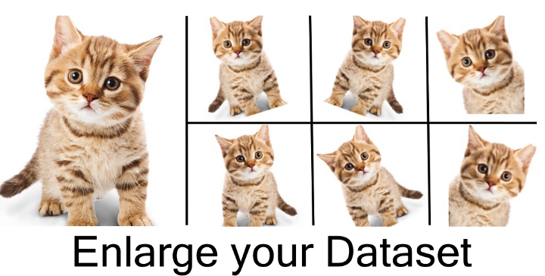
Image Augmentation
VGG16
Image data augmentation is a technique that can be used to artificially expand the size of a training dataset by creating modified versions of images in the dataset.

